Slide 1
Essential Concepts of Organic Chemistry

Slide 2
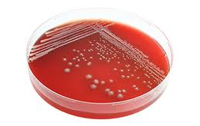
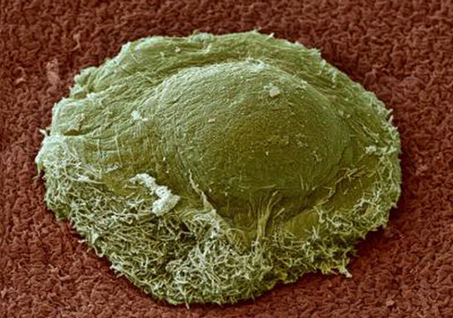

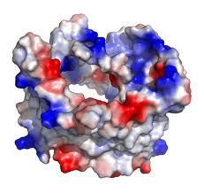
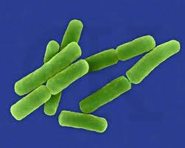
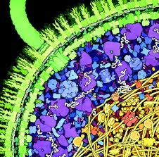
What is a cell ?
Petri Dish
A bacterial colony
A protein
9 Bacteria
E. coli cell wall
Notes:
When we examine a petri dish, we are looking at clumps
<click>
Of around a million bacteria. When we zoom in here
<click>
You can almost make out one of these bacteria from the colony. If we look closer with an electron microscope
<click>
we can see the individual bacteriums more clearly. If we zoom in further
<click>
We get to a size scale that is no longer visible by traditional microscopy, but artists can illustrate what goes on inside. We see individual proteins, the membranes, and a flagella.
<click>
If we zoom in yet further we get to the atomic level in which molecules like proteins, DNAs, and metabolites all have very specific configurations of covalently and noncovalently associated atoms.

Slide 3
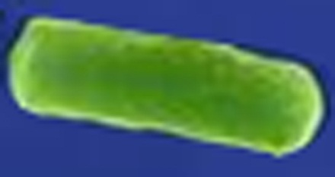
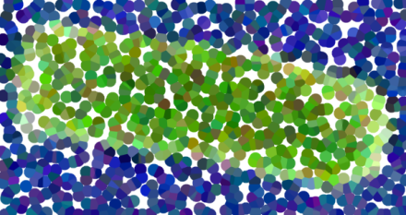

Don’t think of it like this…
‘Molecule’: a graph of atoms connected by edges that are covalent bonds
‘Complex’: a graph of molecules connected by edges that are non-covalent bonds
…it’s like this
(note: not pointillized to scale)
covalent
non-covalent
Notes:
The world is full of tiny balls, called atoms and other fundamental particles like electrons and photons. It is not continuous. From physics we know that atoms are themselves made of yet smaller balls, and in nuclear reactions atoms can be split or joined and thereby change identity. However, at the energy levels that exist in the biological world, nuclear reactions do not occur, so you don’t need to understand anything smaller than atoms.
<click>
Think of atoms for the moment as billiard balls with weird magnets in various positions of their interior that make them interact with other billiard balls in geometrically-defined ways. Those interactions come in two flavors in biology: covalent and noncovalent. The covalent type are really strong, and those are the ones that are made and broken during organic chemical reactions. The noncovalent ones are things like hydrogen bonds with much lower energies.
<click>
In either case, you can describe Graphs that capture the structure of aggregate particles. When we speak of the graph that results from covalent bonds between atoms, we call that a Molecule. When we speak of the graph resulting from non-covalent interactions between Molecules, we call that a Complex.

Slide 4

Can any arbitrary configuration of atoms be a molecule?
No, we have rules!
Schrödinger equation
From Quantum Mechanics
Very accurately describes where the electrons are likely to be around a hydrogen atom
All practical ‘physical’ theories are approximations of Schrodinger
Organics systems can be described by much simpler “rules” that can be understood in terms of this equation
In practice, Schrodinger is rarely needed to understand biology
Notes:
The remainder of what is happening in the cell is defined by the Schrodinger equation. This equation from Quantum Mechanics describes the energies and waveforms of the electrons surrounding the atoms. It describes the various states that the electrons will exist in. Chemical reactions involve changes to these electronic states and transitions of electrons between these states.
The problem with Shrodinger is it turns out to be really difficult to solve. It can only be solved exactly for trivial systems like a Hydrogen atom. It can be solved numerically, though it is computationally intensive, and physical organic chemists will often use such calculations to help them understand observed reactions that defy simpler explanations. However, simpler chemical theories such as VSEPR can explain the great majority of the chemical reactions that happen in biological systems. So, we will focus on this theory.

Slide 5
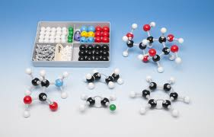
Tinker-Toy Chemistry
(a simplification of VSEPR)
Oxygen = red
Nitrogen = blue
Carbon = black
Hydrogen = white
A double bond
(1 σ + 1 π)
# Bonds Bonding Pattern
Carbon: 4 4 σ (SP₃), 3 σ + 1 π (SP₂), 2 σ + 2 π (SP)
Oxygen: 2 2 σ (SP₃), 1 σ + 1 π (SP₂)
Nitrogen: 3 3 σ (SP₃), 2 σ + 1 π (SP₂)
Hydrogen: 1 3 σ (S)
etc.
Notes:
The VSEPR theory is the one that deals with hybridization on an atom. It is the theory whose consequences are physically encoded in the components of a chemical modeling kit. To make a stable molecule, minimally all the holes in the atom pieces need a bond piece in them. Every end of the bond piece needs to attach to another atom piece. The simplest rule implied by these kits: that carbon likes 4 bonds, oxygen likes 2, nitrogen likes 3, and hydrogen likes 1 are almost always true in the chemical reactions observed for biological systems. Additionally, this view of chemistry implies the existence of two types of bonds: sigma bonds and pi bonds. These bond patterns can be understood as pairings of orbitals between the two atoms. When a carbon, oxygen, or nitrogen atom exists in the sp2 hybridization state, it can use some of its available electrons to make double bonds.

Slide 6
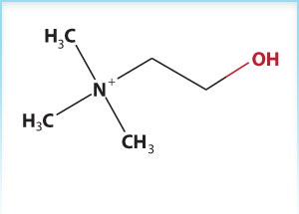
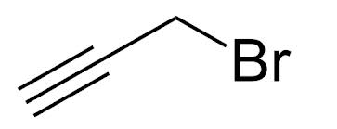
What is the hybridization state of the atoms in these molecules?
Propargyl Bromide
Choline

Slide 7
Tinker-Toy Chemistry
Simple rules for stable CHNOPS chemicals in water
1) Atoms can only exist in these bonding patterns
All bonds need to be satisfied
Only some atoms like to be linked to other atoms:
C-C
C-H
C-N
C-O
C-P
C-S
H-C
H-H
H-N
H-O
H-S
N-C
N-H
N-N
N-O
N-P
N-S
O-C
O-H
O-N
O-O
O-P
P-C
P-H
P-N
P-O
P-S
S-C
S-H
S-N
S-O
S-P
rare, but stable in some contexts
Notes:
Cell-based systems are essentially composed of the same atoms that the Milk Way Galaxy is made of, but are highly enriched for the atoms C H N O P and S. Some common atoms, like helium and neon are inert, so they play no role in biology. Others such as Iron, Magnesium, and Chloride play major roles, but are not involved in forming covalent bonds.
For a chemical to be stable in water it must be a pretty happy molecule. Water is a highly reactive chemical. Most of synthetic organic chemistry used to make plastics and pharmaceuticals is carried out under water-free conditions because water is so reactive. So, much of the diversity that can be generated in the chemistry lab is not accessible in biological systems because the required intermediates and reagents are not stable in water. For example, the Grignard reagent in chemistry contains a Magnesium-carbon bond which reacts violently with water. So, you could never have such bonds in a cell. As a result, the number of distinct bonding patterns in biochemical systems is somewhat constrained, and the ones that make stable covalent bonds are largely limited to CHNOPS.
Here I am filling out the grid of CHNOPS (carbon hydrogen nitrogen phosphorus or sulfur) x CHNOPS and indicating whether that bonding combination is ever observed in biology. The gray ones mean they are super rare, but sometimes observed. You’ll notice that at least half of these pairings are naturally observed, and to a first approximation, this plus the bonding patterns explains the bulk of the diversity observed in biology—pretty much any naturally-occurring chemical must obey these rules.
There are some rare covalent bonds that do not show up on this list. For example, Carbon Fluorine bonds can be generated biologically, but they are very rare in the biosphere.

Slide 8
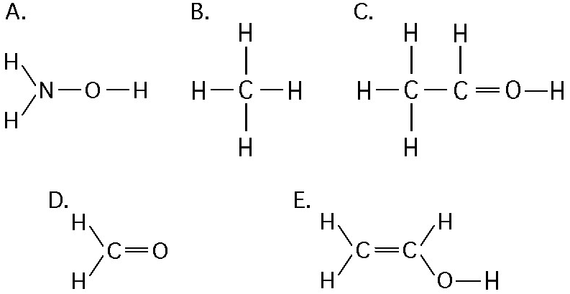
Which of these molecules doesn’t work?
How did you answer that question?
Notes:
The oxygen has three bonds. It would be fine if a positive charge on the proton was indicated, but that is a transient interaction.
The way to answer this is examine the number of bonds associated with each atom, and then compare that to the list of bonds that are commonly observed.

Slide 9
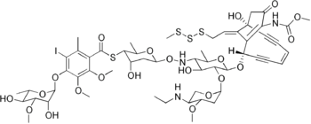
Is there anything wrong with this molecule?
Notes:
It has an atypical S-S-S linkage, and Iodine is rare as is the oxime linkage. The enediyne is also rare, but there is nothing ‘wrong’ with it.

Slide 10
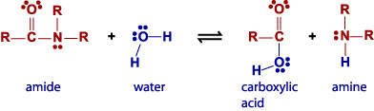
Chemical Reactions
Define a change in the structure of participating molecules
The directionality of the reaction is defined by ‘Gibbs Free Energy’ which will go in the direction that is negative
‘Conservation of matter’ says that atoms and electrons cannot be created nor destroyed during a chemical reaction
So, the number and identity of atoms present on both sides of a reaction as well as the number of bonds, is conserved
Notes:
When something happens in a biological system, it is ultimately being implemented as many chemical reactions. That is most obvious during the biosynthesis of chemicals, but it is also true when you, say, bend your arm – you are breaking oxygen-phosphate bonds in many ATP molecules and modifying the structural state of proteins within your muscle cells. So, we need to understand what chemical reactions can occur.
Chemical reactions define a change in the structure of participating molecules. There is a state to the atoms involved before the reaction, and there is a state when it is complete. The difference in energy between these two states is called the ‘Gibbs Free Energy’, and when it is negative the reaction occurs spontaneously. During a chemical reaction, neither atoms nor electrons can be created or destroyed. They are simply being rearranged. So, the total count of atoms or electrons is conserved across the two sides of the equation.

Slide 11
What happens when the Gibbs free energy is zero?
Notes:
The reaction continues to occur at a similar rate, but it goes both directions and thus the concentration of chemicals in the system remains constant.

Slide 12
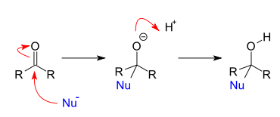
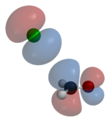
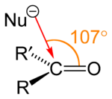
What is a reaction mechanism?
Addition reaction
Electrophilic addition
Nucleophilic addition
Cyclization
Elimination reaction
Beta elimination
E1cB elimination reaction
Organic redox reaction
Pericyclic reaction
Polymerization
Rearrangement reaction
Beckmann rearrangement
Substitution reaction
Electrophilic aromatic substitution
Nucleophilic aromatic substitution
Electrophilic substitution
Nucleophilic substitution
S_{N}1 reaction
S_{N}2 reaction
Reaction mechanisms follow specific patterns of atoms interacting, which are defined by the geometry of the orbitals (where the electrons are localized) present in those atoms
Mechanisms are correlated with functional groups (ie, -SH, -NH2, and –OH are all ‘nucleophiles’ which will participate in similar mechanisms)
Notes:
What happens ‘under the arrow’ of the chemical reaction is not arbitrary. There are precise geometric events occuring on these molecules – the atoms don’t just fall apart and rearrange; they must react through a constrained set of mechanisms such as nucleophillic substitution or elimination. In organic chemistry, the number of mechanisms available is fairly rich, primarily because transition metal complexes (things made with carbons bonded to atoms like palladium) do fancier things. However, these molecules aren’t stable in water, so there are very few mechanisms available to biological systems.
Most biological reactions fall under the categories of nucleophillic substitution. Elimination reactions, or addition reactions.

Slide 13
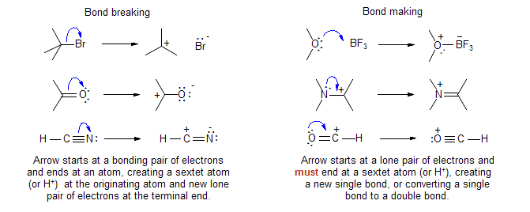
Arrow pushing
http://www.chem.wisc.edu/areas/reich/handouts/elecpush/epush-1.htm
Electron pushing arrows are used as a bookkeeping device to keep track of bonding when depicting reaction mechanisms
Notes:
Reaction mechanisms can be represented visually using arrow pushing. The link here describes how it is done in more detail. Bond breaking arrows originate on a bond and point to the atom that will receive a pair of electrons. Bond making arrows initiate on a lone-pair of electrons on an atom and point to the atom they will become bonded to.

Slide 14
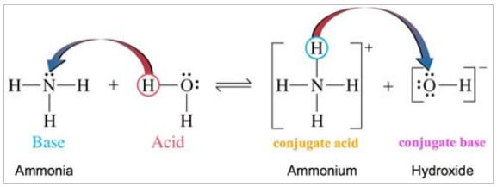
What’s wrong with this drawing?
Notes:
Biochemists often use arrows in ways that don’t actually mean arrow pushing. For example, here the scientist is showing the movement of a proton from an acid to a base. To draw this more accurately, the electrons on the base should be attacking the proton, and then the bond between the H and O should be broken with the electrons returning to the oxygen. In the product ‘conjugate base’, the electrons are not distributed across the entire hydroxide molecule as implied, they are localized to the oxygen atom.
So, the point here is be a little careful in reading the diagrams in figures – sometimes people use the notations of organic chemistry loosely.

Slide 15
Push the arrows in this reaction:
Notes:
The oxygen on water attacks the amide carbon kicking up electrons on oxygen to get a tetrahedral intermediate. Those electrons then kick down and eliminate NR2.

Slide 16

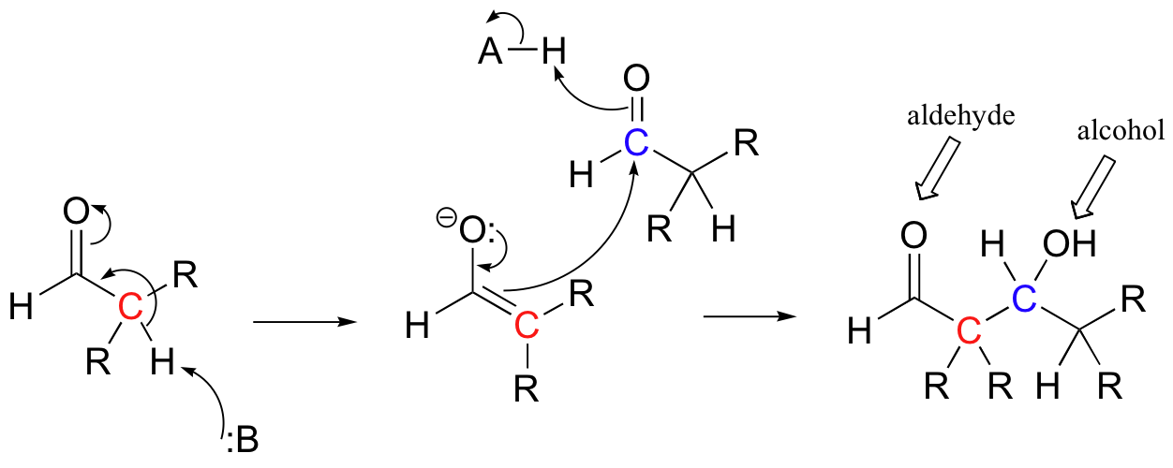
What happens in this mechanism?

Slide 17
Object Oriented Programming

Slide 18
What are Objects?
Bundles of information
Many common languages have some notion of ‘objects’ including C++, Java, JavaScript, Python, JSON, XML
Slightly different in different languages
Notes:
In object oriented programming, “Objects” usually refer to bundles of information. For example, you can describe a Car as having ‘number_of_wheels = 4’ and ‘license_plate = 4BIUO11’, and this bolus of electronic information represents the physical entity in a computer. In this course, we will use Objects to describe the chemistry, design, and simulation concepts associated with genetic engineering.
Many common programming languages have some notion of ‘objects’ including C++, Java, JavaScript, Python, JSON, and XML.
However, they behave differently in different classes. In some languages, their behavior really is restricted to just holding the state of some data fields. In other languages, objects can have fields that execute functions. Some languages like JavaScript and the related JSON have ‘dynamic’ objects in which the fields can change, while others are strictly declarative of their fields. For our purposes in this course, we will not need this dynamic behavior. However, I will use JSON because it is simple.

Slide 19

Simple example: an Email
To address,
From address
Message
Subject
Notes:
Let’s look at an example. An Email is a piece of electronic information. You have a concept in your mind of an email. You can print out the email and then it has a physical representation. The email is an object. There are many trillions of instances of emails. However, they all have the same structure. They all have to and from addresses, a subject, and a message.
”].

Slide 20
Simple example: an Email
Represented in JSON:
{
"to": "hiring@123publishing.com",
"from": "jcanderson@berkeley.edu",
"subject": "Editorial Assistant Posi...",
"message": "Dear Hiring Manager...",
}
A JSON array
[“red”, ”blue”, “green”]
Notes:
I can represent this bolus of information in JSON. The syntax for representing an object in JSON is to put it in set brackets. The many fields of the object are separated by commas. Each field of the JSON is described by a key such as ‘to’, ‘from’, ‘subject’, or ‘message’. The key is surrounded by quotes, followed by a colon, followed by the ‘value’. So, the value associated with the key ‘to’ is ‘hiring@123publishing.com’. The value can be a String, a Number, a JSON object, or a JSON array.
<click>
These arrays are lists of other values, and arrays are expressed as an ordered list of values separated by commas and surrounded by square brackets. So, for example, a list of color names would be represented by [“red”, ”blue”, “green”].

Slide 21
What does the following code do?
var anobject = {};
anobject.name = “bob”;
function execute(obj) {
println(“I have “ + obj.name);
}
execute(anobject);
Notes:
It prints “I have bob” to the output of the IDE.

Slide 22
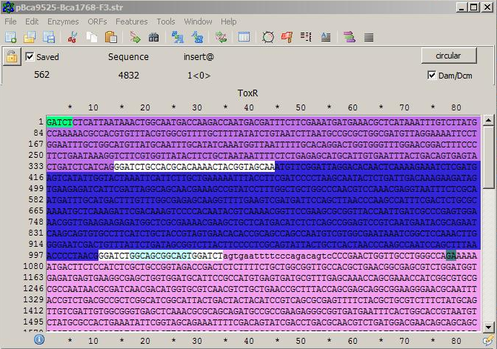
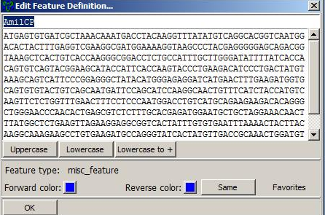
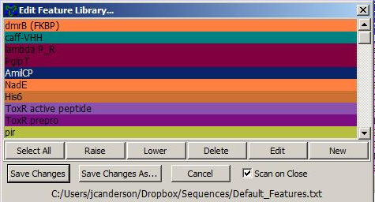
Syn Biol example: a Feature
Represented in JSON:
{
“name": “ToxR”,
“sequence": "ATGTTCGGATTAGGACACAACTCA...",
“for_color": “blue",
“rev_color": “red",
“author": “jcanderson“
“type": “misc_feature“
}
Notes:
One example from the domain of biology is that of a Feature. In ApE, you go Features > Edit Feature Library
<click>
and you get this GUI that shows the names of a list of features. You can double click
<click>
on the name to get a description of the contents of the Feature object such as its name, its sequence, its colors, etc.
<click>
We can represent this feature in JSON by describing it as an object composed of fields described as key/value pairs. Those keys are name, sequence, for_color, and so forth.

Slide 23
Demo of ApE
Notes:
Google “a plasmid editor”. Download and enjoy.

Slide 24
An Array of Features
[
{
“name": “ToxR”,
“sequence": "ATGTTCGGATTAGGACACAACTCA...",
“for_color": “blue",
“rev_color": “red",
“author": “jcanderson“
“type": “misc_feature“
},
{
“name": “Bla”,
“sequence": "atgagcacttttaaagttct...",
“for_color": “orange",
“rev_color": “redorange",
“author": “CindySu“
“type": “resistance_gene“
},
{
“name": “SpecR”,
“sequence": "ATGCGCTCACGCAACTGGTCCA...",
“for_color": “yellow",
“rev_color": “pink",
“author": “jasong“
“type": “resistance_gene“
},
]
Notes:
We could express the entire list of features described in ApE as an array composed of multiple JSONs.

Slide 25
But what if have many Features?
{
“name": “ToxR”,
“sequence": "ATGTTCGGATTAGGACACAACTCA...",
“for_color": “blue",
“rev_color": “red",
“author": “jcanderson“
“type": “misc_feature“
}
{
“name": “Bla”,
“sequence": "atgagcacttttaaagttct...",
“for_color": “orange",
“rev_color": “redorange",
“author": “CindySu“
“type": “resistance_gene“
}
{
“name": “SpecR”,
“sequence": "ATGCGCTCACGCAACTGGTCCA...",
“for_color": “yellow",
“rev_color": “pink",
“author": “jasong“
“type": “resistance_gene“
}
Notes:
Let’s examine the similarities between different objects.

Slide 26
But what if have many Features?
{
“name": “ToxR”,
“sequence": "ATGTTCGGATTAGGACACAACTCA...",
“for_color": “blue",
“rev_color": “red",
“author": “jcanderson“
“type": “misc_feature“
}
{
“name": “Bla”,
“sequence": "atgagcacttttaaagttct...",
“for_color": “orange",
“rev_color": “redorange",
“author": “CindySu“
“type": “resistance_gene“
}
{
“name": “SpecR”,
“sequence": "ATGCGCTCACGCAACTGGTCCA...",
“for_color": “yellow",
“rev_color": “pink",
“author": “jasong“
“type": “resistance_gene“
}
Notes:
The all have the same list of keys, but the values are different for each instance. The pattern shared between similar objects defines a class of information, and this similarity is defined by the list of keys they all share and constraints on the values permitted for each field. You call the entity that describes this ‘form of the data’ a data structure, and specific languages will refer to it as a Class or Schema. It represents the structure of the data.

Slide 27
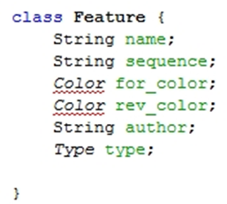
A JSON serialization of an instance of Feature
{
“name": “Bla”,
“sequence": "atgagcacttttaaagttct...",
“for_color": “orange",
“rev_color": “redorange",
“author": “CindySu“
“type": “resistance_gene“
}
A (Java) Class:
Notes:
I can encode this data structure in the form of a Java class. The class states the list of keys and what type of value they contain. This specific piece of information about the beta lactamase feature, when held in memory as a Java Object, is referred to as an instance of the ‘Class’ called ‘Feature’.

Slide 28
What are the components of a Java class?
Notes:
Methods, variables, and a constructor

Slide 29
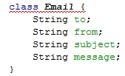

Inheritance and extending classes
Notes:
Going back to our Email example, we can now describe the data structure present in the Email object as an Email class. Another essential concept in object oriented programming is that classes can have inheritance. Our Email class is very general. It just encodes the bare minimal information that all email messages share. If I was to restrict the objects I am describing to just Gmails, I’d undoubtedly find all sorts of additional information that all Gmails have, but other types of Emails such as Yahoo or Hotmail don’t have. I can capture this relationship between the Gmail and the more general Email by saying that Gmail ‘extends’ Email
<click>
By stating that Gmail extends Email, we are saying “include everything you had in Email, then add this other data to it”. So, for example, there might be routing codes or various types of attachment that would be included in the Gmail class.

Slide 30
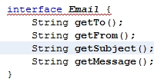
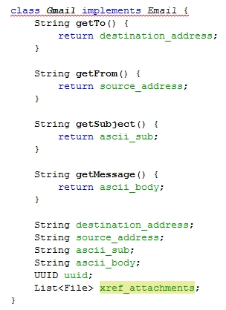
Interfaces and ‘implements’
Notes:
In Java, there are two types of inheritance. A class can extend another class, or implement an interface. A class can only extend one parent class, however it can implement any number of interfaces. An interface is like an abridged version of a class. The fields in a class can refer to both pieces of data, like a String, or methods that do actions. An interface is only allowed to encode the methods. You can distinguish a method from data in Java by looking for parentheses following the field name. So, for example, String getTo without parentheses would refer to a String whose field name is getTo; while getTo() with the parentheses means a method that will execute when run and return a String. Additionally, all the methods defined in an interface are abstract which here means that the body of what to do when the method is invoked is not defined in the interface. The interface is simply a promise that this method will be concretized by any implementing class.
So, we can express the same concept of an Email object in terms of an interface in which we promise that Strings of four types will be made available by any implementing class. We can then describe the Gmail class as implementing Email and providing methods that will satisfy the generation of these returned Strings.

Slide 31
Does it matter if you use inheritance versus extension?
Notes:
Not really. They are mostly interchangeable, but the fact that you can only extend once and can implement many times usually drives the decision.

Slide 32
Summary
Objects describe a bolus of information
Classes (or ‘Schemas’) describe the structure of information in an Object
Classes standardize information
Inheritance somewhat means ‘take everything about this other Class and then add this additional stuff to it’
In Java, inheritance can be achieved by extending classes or implementing interfaces
For more info: take CS 61B Data Structures, or read http://math.hws.edu/javanotes/

Slide 33
Describe a Java Class representation of a human being’s person information that includes their contact information of various sorts.
Describe in json an instance of that class.

Slide 34
Formal Descriptions of Chemical Structure
Notes:
In this section, we will build up data structures to describe the state of a biological system. At any given time, you can think of a cell has being a complex data structure ultimately composed of atoms. There are changes in state of these atoms in terms of their position constantly occurring that gives rise to the behavior we call life.

Slide 35
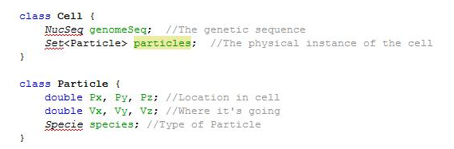
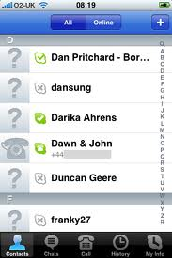

What is a cell ?
Grades
Bobby : A
Suzy : A
Bill : C
Karen : B
Set<Student>
no order
unique
List<Student>
ordered
uniqueness NR
Map<Student, Character>
Notes:
I want you to think of a cell as having two things: a physical representation in reality in the form of particles, and as a design abstraction in the form of a sequence object. We’ll represent the sequence in the form of a NucSeq, and the physical atoms as a Set of Particles.
<click>
A set in Java is like the group of students in a classroom. They are all unique, and they often sit in different seats. There is no immediate motivation or method for ranking them, but the key point is that each person can only exist once within this collection of students. Things like this in which all members are unique and they have no intended order are called Sets. In the case here, we have a Set of particles, which basically will mean atoms. And that’s it. There is nothing more going on in a cell. Those particles have a position, a velocity, and based on this Species description, they have some identity that defines their behavior.
The genetic composition of the cell is in essence already captured if we describe the full structure of interactions between atoms in this particles Set. However, the emergent property of replication enables a novel abstraction to exist that is this simple idea of genetic composition described as a String of letters. Therefore, we will capture this useful abstraction as a separate data structure called the NucSeq.

Slide 36
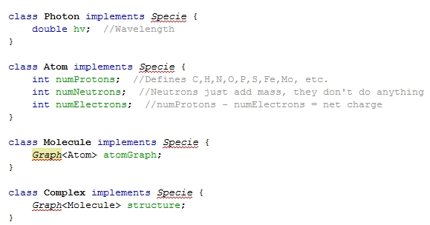
Top-level Species
Notes:
Alright. At the most basic level we can discuss 4 classes of Species: photons, atoms, molecules, and complexes. The photon is entirely defined by its wavelength which is a simple real number expressed in nanometers. An Atom is defined by its number of protons, neutrons, and electrons. Based on the number of protons, one can look up the name of the atom like ‘carbon’ or ‘sulfur’. So, we don’t have to include both pieces of information – numProtons is sufficiently expressive. All these counts are integers because each particle is itself quantized – you can’t have half an electron. A Molecule is a structure representing a Graph of Atom objects connected by covalent bonds. Finally, a Complex is a structure represented by Graph of Molecules held together through non-covalent bonds.

Slide 37
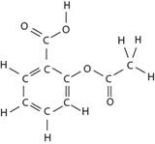
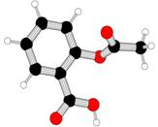
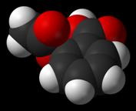
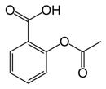
Representation of molecules
All atoms (never used)
Organic (JACS)
Ball-and-stick
Space Filling
2-acetoxybenzoic acid
O=C(Oc1ccccc1C(=O)O)C
IUPAC name
SMILES
InChI=1S/C9H8O4/c1-6(10)13-8-5-3-2-4-7(8)9(11)12/h2-5H,1H3,(H,11,12) Key:BSYNRYMUTXBXSQ-UHFFFAOYSA-N
Acetylsalicylic acid
Common name
InChI
Notes:
There are many ways of expressing this graph that is a Molecule. Here we see 8 different-but-equivalent ways of expressing the structure of the chemical in Aspirin pills. For visual consumption, you can draw an all atoms structure showing every bond and every atom in the molecule. These are cumbersome to look at and draw, so this representation is rarely used. Organic chemists will typically employ a condensed version of the all-atoms view by omitting all the hydrogens bonded to carbon. A ball-and-stick model captures a 3-dimension conformation of the atoms. It captures the structure, the lengths of the bonds, and their relative positioning. A space filling model is like ball-and-stick, but it also captures the radius of each atom and thereby gives the viewer some notion of the surface shape of the molecule.
<click>
For verbal communication, there is a formal rule-based nomenclature called IUPAC, but older common names persist. Because IUPAC names can get long and cumbersome, many people prefer to use the common names.
<click>
For computer-readable serialization, the SMILES and InChI formats capture the structure of the molecule as a short String.
All these representations ultimately mean the same thing and are usually interconvertible.

Slide 38
Which of the following conversions results in information loss?
A
All atoms (never used)
Ball-and-stick
B
O=C(Oc1ccccc1C(=O)O)C
SMILES
Space Filling
C
All atoms (never used)
Organic (JACS)

Slide 39
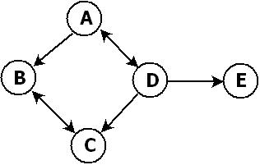
What is a ‘Graph’?
Nodes
Edges
Mathematical definition
A graph is an ordered pair, G = <V, A>, where V is the set of nodes, and A, the set of edges, is itself a set of ordered pairs of nodes.
The following expressions describe the graph shown above in set-theoretic language:
V = {A, B, C, D, E}
A = {<A, B>, <A, D>, <B, C>, <C, B>, <D, A>, <D, C>, <D, E>}
Notes:
A Graph is mathematically defined as an ordered pair of two sets.
<click>
One of these two sets, V is the set of nodes. For a Molecule, each atom is a Node. The other set
<click>
Is the set of edges, which is itself expressed as a set of ordered pairs of nodes.

Slide 40



What is a ‘Graph’ (in Java)?
Notes:
To encode a Graph in Java, you would declare a class called ‘Graph’ that is composed of a Set of Nodes and a set of Edges. Node would be a class that perhaps have a label such as name, and the Edge is a pair of two Nodes. In this case, the Edge has directionality – we distinguish the from and to nodes.

Slide 41
What is a ‘Graph’ for molecules?
class Molecule {
List<Atom> _nodes;
Set<Bond> _edges;
}
class Atom {
…
}
class Bond {
int _from;
int _to;
}
Notes:
To express a Graph representation of a Molecule, we would encode the Molecule as a List<Atom> and a Set<Bond>. A List in Java means an ordered list – each atom will have a specific index or position within this list. We have already defined the class Atom as being three integers for expressing its number of protons, neutrons, and electrons. We then can express the bonds as being integers pairs referencing the position of the atom in question from the _nodes List.

Slide 42
What is a ‘Graph’ for molecules?
class Molecule {
List<Character> _atoms;
Set<Bond> _edges;
}
class Bond {
int _from;
int _to;
}
Notes:
For purposes of discussion, I’ll simplify our representation of the Molecule to just be a List<Character> in which we use the letter codes like C for carbon, O for oxygen, etc. to describe the Atoms.

Slide 43
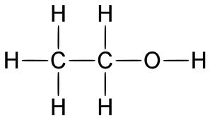
Molecules as a Graph
1
4
0
3
5
7
8
2
6
V = [H, H, H, C, H, C, H, O, H]
A = [<0,3>, <1,3>, <2,3>, <4,5>, <6,5>, <3,5>, <5,7>, <7,8>]
Notes:
Let’s look at an example of the graph representing ethanol.
<click>
I’ll arbitrarily assign an index to each atom in the molecule. There are 9 atoms, so there are 9 indices and my List<Atom> will have a size of 9.
<click>
If I now list out the letter code for each atom, I construct the Atom List.
<click>
For each bond in the molecule, I’ll express the indices that the bonds connect together. So, for example, the left most bond between the hydrogen labeled zero and the carbon labeled 3 would be a bond <0,3>.

Slide 44
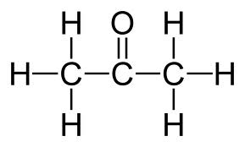
Describe the following molecule as a Graph:
Notes:
Number the atoms
Write out the letter code for each atom as an array
Write out pairs of indices as an array for each covalent bond

Slide 45
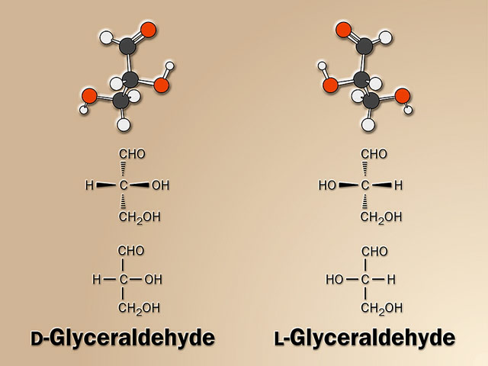
Stereochemistry
Notes:
Stereochemistry deals with the fact that two molecules can be identical in terms of the attachment of the atoms, but nevertheless different in three dimensional shape. For biological molecules, this comes from the fact that carbon has 4 bonds, and when in the SP3 hybridization state having 4 different things attached to the carbon atom can be in two different configurations that are mirror images of each other. Because of this, many organic molecules are “chiral” and their mirror image is a distinct molecule.
Note that this representation I have provided for a Molecule neglects stereochemistry. This could be easily remedied by introducing a List<Boolean> to represent each atom in the node list as being the R or S configuration. Though stereochemistry is important to accurately describe things, we will ignore it for the sake of simplificity for now.

Slide 46
What is the relationship between my two hands?
Notes:
They are pseudo-entantiomers of one another – they are the mirror image of each other.

